Slide 1
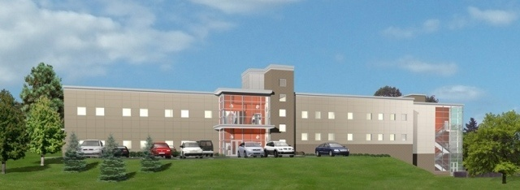
SUPPORT SERVICES BUILDING
PENN STATE MILTON S. HERSHEY MEDICAL CENTER
PENN STATE AE SENIOR THESIS FINAL PRESENTATION
WILL LAZRATION
CONSTRUCTION MANAGEMENT - DR. RILEY

Slide 2
SUPPORT SERVICES BUILDING
PENN STATE MILTON S. HERSHEY MEDICAL CENTER
PRESENTATION OUTLINE
WILL LAZRATION
CONSTRUCTION MANAGEMENT
PROJECT BACKGROUND
ANALYSIS #1: FOUNDATION RE-DESIGN
  Initial Conditions
  Re-Design
ANALYSIS #2: ROOFING
  Part I: Roofing Type Comparison
  Part II: Elimination of Offset Roof
ANALYSIS #3: RENEWABLE ENERGY SOURCES
  Part I: Geothermal System
  Part II: Installation of PV Array
    Site Analysis
    System Design (Electrical Breadth)
LESSONS LEARNED
ACKNOWLEDGEMENTS

Slide 3
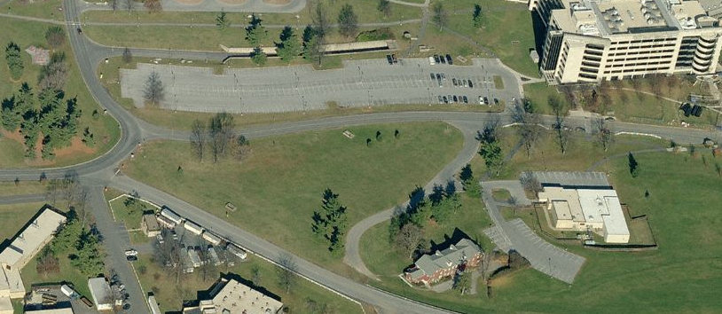
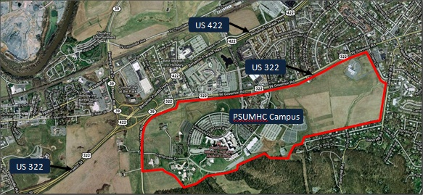
SUPPORT SERVICES BUILDING
PENN STATE MILTON S. HERSHEY MEDICAL CENTER
PROJECT BACKGROUND
WILL LAZRATION
CONSTRUCTION MANAGEMENT
PRESENTATION OUTLINE:
PROJECT BACKGROUND
ANALYSIS #1: FOUNDATION RE-DESIGN
  Initial Conditions
  Re-Design
ANALYSIS #2: ROOFING
  Part I: Roofing Type Comparison
  Part II: Elimination of Offset Roof
ANALYSIS #3: RENEWABLE ENERGY
  Part I: Geothermal System
  Part II: Installation of PV Array
    Site Analysis
    System Design (E)
LESSONS LEARNED
ACKNOWLEDGEMENTS
OWNER:
  Pennsylvania State University
    Hershey Medical Center
LOCATION:
  Hershey Medical Center – Hershey PA
BUILDING INFORMATION
  42,796 SF
  2 Stories + 1,000 SF Basement
  Built Atop Existing Utility Tunnel
SSB Site
PROJECT INFORMATION
  Delivery Method: Design-Bid-Build
  Contract Type: CM @ Risk
  Project Cost: $14,395,331.00 GMP
  Constriction Dates: 6-1-2010 – 8-31-2011

Slide 4
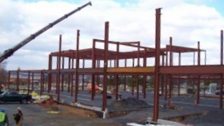
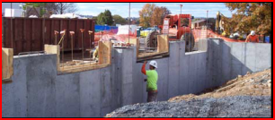
SUPPORT SERVICES BUILDING
PENN STATE MILTON S. HERSHEY MEDICAL CENTER
PROJECT BACKGROUND
WILL LAZRATION
CONSTRUCTION MANAGEMENT
PRESENTATION OUTLINE:
PROJECT BACKGROUND
ANALYSIS #1: FOUNDATION RE-DESIGN
  Initial Conditions
  Re-Design
ANALYSIS #2: ROOFING
  Part I: Roofing Type Comparison
  Part II: Elimination of Offset Roof
ANALYSIS #3: RENEWABLE ENERGY
  Part I: Geothermal System
  Part II: Installation of PV Array
    Site Analysis
    System Design (E)
LESSONS LEARNED
ACKNOWLEDGEMENTS
STRUCTURAL SYSTEM
  Micropiles
  Pile caps and gradebeams
  Rigid Structural Steel Frame
EXTERIOR ENCLOSURE:
  Arriscraft Masonry veneer with CMU backup
  Centria Metal Panels
  Glazed Aluminum Curtain Wall
  3-ply Cold Applied Built-Up Roof

Slide 5
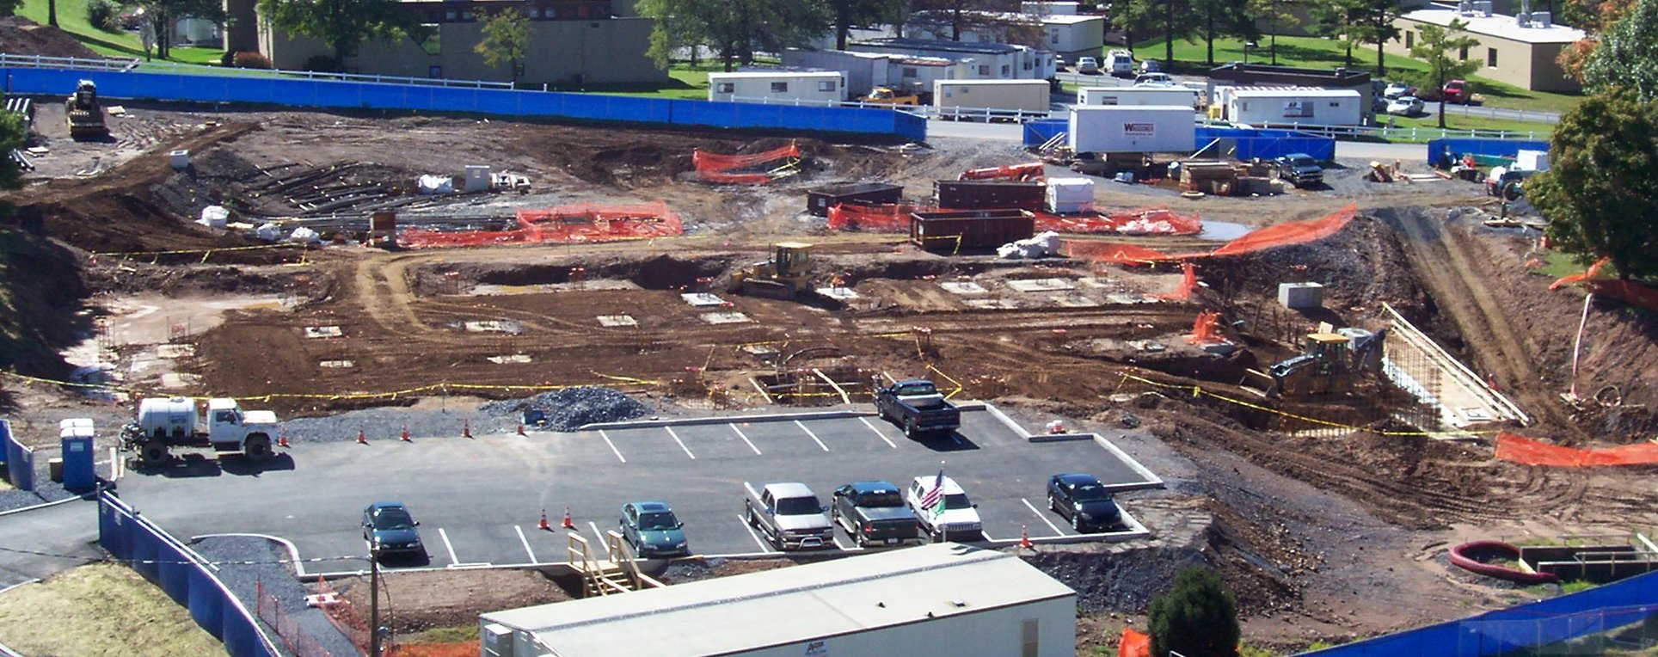
SUPPORT SERVICES BUILDING
PENN STATE MILTON S. HERSHEY MEDICAL CENTER
ANALYSIS I: FOUNDATION REDESIGN
WILL LAZRATION
CONSTRUCTION MANAGEMENT
PRESENTATION OUTLINE:
PROJECT BACKGROUND
ANALYSIS #1: FOUNDATION RE-DESIGN
  Initial Conditions
  Re-Design
ANALYSIS #2: ROOFING
  Part I: Roofing Type Comparison
  Part II: Elimination of Offset Roof
ANALYSIS #3: RENEWABLE ENERGY
  Part I: Geothermal System
  Part II: Installation of PV Array
    Site Analysis
    System Design (E)
LESSONS LEARNED
ACKNOWLEDGEMENTS
PROBLEM IDENTIFICATION
  Micropile foundation recommendations based on significantly larger loads
  Micropiles are expensive
  Installation Issue arose on project
RESEARCH GOALS
  Perform preliminary foundation resign
  Reduce total project cost
  Reduce overall project schedule

Slide 6
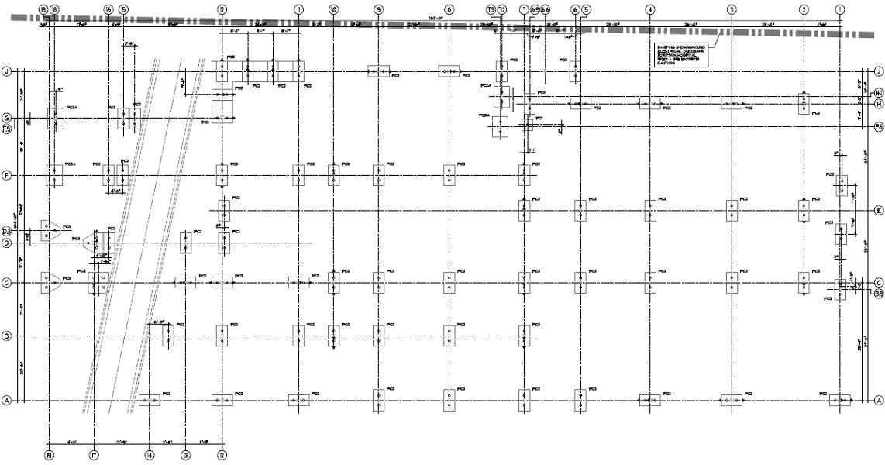
SUPPORT SERVICES BUILDING
PENN STATE MILTON S. HERSHEY MEDICAL CENTER
ANALYSIS I: FOUNDATION REDESIGN
WILL LAZRATION
CONSTRUCTION MANAGEMENT
PRESENTATION OUTLINE:
PROJECT BACKGROUND
ANALYSIS #1: FOUNDATION RE-DESIGN
  Initial Conditions
  Re-Design
ANALYSIS #2: ROOFING
  Part I: Roofing Type Comparison
  Part II: Elimination of Offset Roof
ANALYSIS #3: RENEWABLE ENERGY
  Part I: Geothermal System
  Part II: Installation of PV Array
    Site Analysis
    System Design (E)
LESSONS LEARNED
ACKNOWLEDGEMENTS
GEOTECHNICAL REPORT REVIEW
  Based on 350K and 250K Column Loads
  Karstic Bedrock (average depth: 40ft)
  Mostly moist & stiff Silts & Clays
  Bearing Capacity 2,000 PSF
CL 19
CL 12
CL 1
350K
250K
ACTUAL COLUMN LOADS & ESTIMATED SETTLEMENTS
  350K loads acceptable,
  250K >> 98K Average (196K Max, 20K Min)
  Settlements still >1” (Column lines 1-12)
=> Soil Improvement Needed

Slide 7
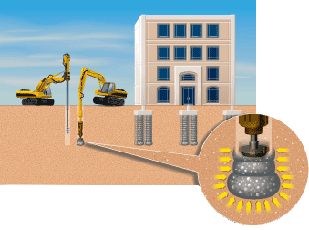
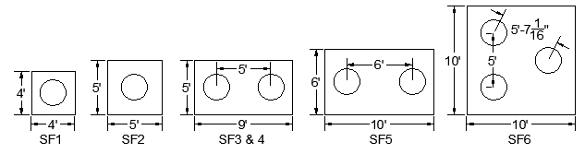
SUPPORT SERVICES BUILDING
PENN STATE MILTON S. HERSHEY MEDICAL CENTER
ANALYSIS I: FOUNDATION REDESIGN
WILL LAZRATION
CONSTRUCTION MANAGEMENT
PRESENTATION OUTLINE:
PROJECT BACKGROUND
ANALYSIS #1: FOUNDATION RE-DESIGN
  Initial Conditions
  Re-Design
ANALYSIS #2: ROOFING
  Part I: Roofing Type Comparison
  Part II: Elimination of Offset Roof
ANALYSIS #3: RENEWABLE ENERGY
  Part I: Geothermal System
  Part II: Installation of PV Array
    Site Analysis
    System Design (E)
LESSONS LEARNED
ACKNOWLEDGEMENTS
FOOTING SCHEDULE
ID | Footing Size | Depth (ft) | # of Geopier® Elements | Depth of Geopier®(s) (ft)
SF1 | 4'-0" x 4'-0" | 3'-9" | 1 | 14
SF2 | 5'-0" x 5'-0" | 3'-9" | 1 | 16
SF3 | 5'-0" x 9'-0" | 3'-9" | 2 | 18
SF4 | 5'-0" x 9'-0" | 5'-0" | 2 | 20
SF5 | 6'-0" x 10'-0" | 3'-9" | 2 | 20
SF6 | 10'-0" x 10'-0" | 3'-9" | 3 | 20
GEOPIER RAMMED AGGREGATE PIERS
  Relatively Newer Technology
  2-3’ Drilled Hole filled with compacted aggregate in 1-2’ lift
  Proven System on Medical Center’s Campus (Centerview Parking Garage)
SPREAD FOOTING DESIGN WITH GEOPIERS (CL 1-12)
  30” Diameter pier (S) increased Soil Bearing Capacity to 5,000 PSF
  Minimum Geopier Element Spacing (2x Diameter)Ruled Design
  Limited Settlement to under ¾”
  Limited Differential Settlement to under ½”
Image Taken from www.geopier.com

Slide 8
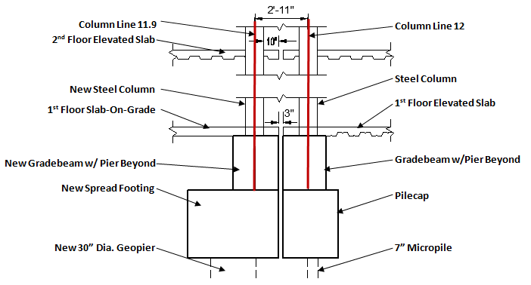
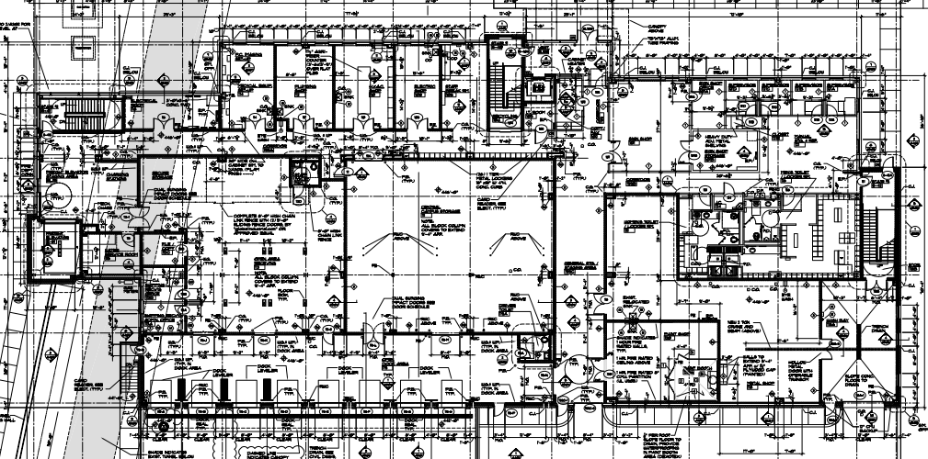
SUPPORT SERVICES BUILDING
PENN STATE MILTON S. HERSHEY MEDICAL CENTER
ANALYSIS I: FOUNDATION REDESIGN
WILL LAZRATION
CONSTRUCTION MANAGEMENT
PRESENTATION OUTLINE:
PROJECT BACKGROUND
ANALYSIS #1: FOUNDATION RE-DESIGN
  Initial Conditions
  Re-Design
ANALYSIS #2: ROOFING
  Part I: Roofing Type Comparison
  Part II: Elimination of Offset Roof
ANALYSIS #3: RENEWABLE ENERGY
  Part I: Geothermal System
  Part II: Installation of PV Array
    Site Analysis
    System Design (E)
LESSONS LEARNED
ACKNOWLEDGEMENTS
ADDED COLUMN LINE 11.9
  Isolated the two foundation types
  Able to withstand vertical movements
  Separates SOG from 1st floor elevated deck
Column Line 11.9
CMU Shafts that extend from 1st floor to the roof
Column Line 12
Added Column Line 11.9
LATERAL LOADS
  Utilize elevator & stair tower CMU shafts
  Extend 1st floor CMU @ Central Campus Storage to roof
1st floor CMU walls to be extended to the roof

Slide 9
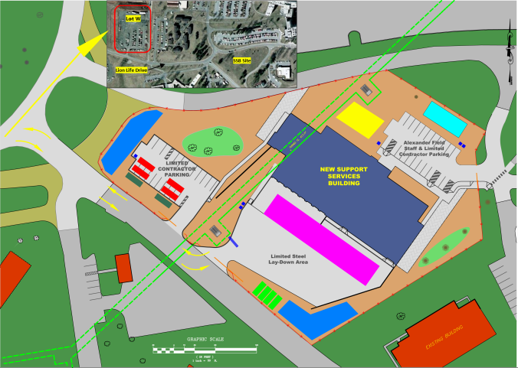
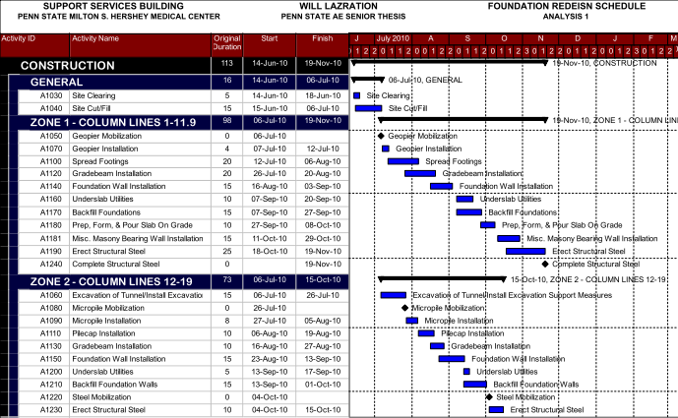
SUPPORT SERVICES BUILDING
PENN STATE MILTON S. HERSHEY MEDICAL CENTER
ANALYSIS I: FOUNDATION REDESIGN
WILL LAZRATION
CONSTRUCTION MANAGEMENT
PRESENTATION OUTLINE:
PROJECT BACKGROUND
ANALYSIS #1: FOUNDATION RE-DESIGN
  Initial Conditions
  Re-Design
ANALYSIS #2: ROOFING
  Part I: Roofing Type Comparison
  Part II: Elimination of Offset Roof
ANALYSIS #3: RENEWABLE ENERGY
  Part I: Geothermal System
  Part II: Installation of PV Array
    Site Analysis
    System Design (E)
LESSONS LEARNED
ACKNOWLEDGEMENTS
SCHEDULE IMPLICATIONS
  Original structural steel completion date: November 29th
  Work on both foundation systems (zones) simultaneously
  New structural steel completion date: November 19th
  2 week reduction in overall project schedule
Northern Gate
SITE LOGISTICS IMPLICATIONS
  Zone 2 utilize northernmost gate & northern side of site
  Zone 1 utilize southernmost gate & southern side of site
Southern Gate

Slide 10
SUPPORT SERVICES BUILDING
PENN STATE MILTON S. HERSHEY MEDICAL CENTER
ANALYSIS I: FOUNDATION REDESIGN
WILL LAZRATION
CONSTRUCTION MANAGEMENT
PRESENTATION OUTLINE:
PROJECT BACKGROUND
ANALYSIS #1: FOUNDATION RE-DESIGN
  Initial Conditions
  Re-Design
ANALYSIS #2: ROOFING
  Part I: Roofing Type Comparison
  Part II: Elimination of Offset Roof
ANALYSIS #3: RENEWABLE ENERGY
  Part I: Geothermal System
  Part II: Installation of PV Array
    Site Analysis
    System Design (E)
LESSONS LEARNED
ACKNOWLEDGEMENTS
ESTIMATED COSTS
ELIMINATED ITEMS
Micropiles | $460,500.86
Pilecaps | $27,214.29
Moment Connections | $15,000.00
Total of Deleted Items: | $502,715.05
Eliminated Items
  101 Micropiles
  51 Pilecaps
Added Items
  93 Geopiers
  259 CY of Concrete
  5.69 Ton of Reinforcing
  8.5 Ton of Structural Steel
NEW DESIGN
Geopiers® | $199,796.70
Spread Footings | $93,820.78
Added Gradebeam & Piers | $20,467.06
Expansion Joint | $14,240.45
Structural Steel | $32,065.51
CMU Lateral Load Walls | $30,000.00
Contingency | $18,171.11
Total Cost of New Design: | $408,410.03
General Conditions Savings
  2 Weeks
Cost of New Foundation Design | $408,410.03
Cost of Deleted Elements | -$502,715.05
General Conditions Savings (2 weeks) | -$28,567.25
Total Cost Savings: | -$122,872.27
GENERAL CONDITIONS
Weekly | $14,283.62
Total for 2 Weeks: | $28,567.25

Slide 11
SUPPORT SERVICES BUILDING
PENN STATE MILTON S. HERSHEY MEDICAL CENTER
ANALYSIS I: FOUNDATION REDESIGN
WILL LAZRATION
CONSTRUCTION MANAGEMENT
PRESENTATION OUTLINE:
PROJECT BACKGROUND
ANALYSIS #1: FOUNDATION RE-DESIGN
  Initial Conditions
  Re-Design
ANALYSIS #2: ROOFING
  Part I: Roofing Type Comparison
  Part II: Elimination of Offset Roof
ANALYSIS #3: RENEWABLE ENERGY
  Part I: Geothermal System
  Part II: Installation of PV Array
    Site Analysis
    System Design (E)
LESSONS LEARNED
ACKNOWLEDGEMENTS
CONCLUSION
  Foundation design based on significantly higher loading conditions
  Redesigned foundation system reduced both cost and schedule
RECOMMENDATIONS
  Architects/Engineers should strongly consider Geopier foundation elements vs. micropiles
  Consider actual loading conditions before making final determination on proper foundation system

Slide 12
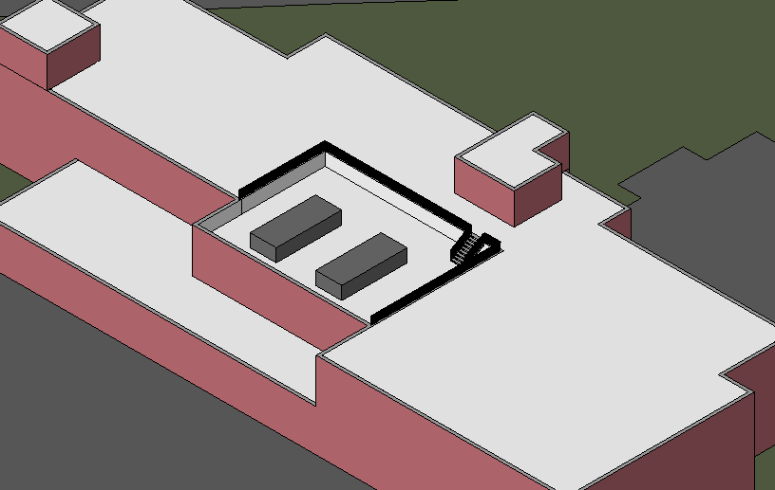
SUPPORT SERVICES BUILDING
PENN STATE MILTON S. HERSHEY MEDICAL CENTER
ANALYSIS II: ROOFING
WILL LAZRATION
CONSTRUCTION MANAGEMENT
PRESENTATION OUTLINE:
PROJECT BACKGROUND
ANALYSIS #1: FOUNDATION RE-DESIGN
  Initial Conditions
  Re-Design
ANALYSIS #2: ROOFING
  Part I: Roofing Type Comparison
  Part II: Elimination of Offset Roof
ANALYSIS #3: RENEWABLE ENERGY
  Part I: Geothermal System
  Part II: Installation of PV Array
    Site Analysis
    System Design (E)
LESSONS LEARNED
ACKNOWLEDGEMENTS
PROBLEM IDENTIFICATION
  Cold Applied BUR is both expensive and has slow installation rate
  Cold Applied BUR is not often considered the most sustainable roof
  3,600SF Offset Roof required additional time and material all to hide rooftop RTU’s
RESEARCH GOALS
  Compare several roofing types on sustainability, cost, & schedule
  Determine both cost and schedules savings with elimination of offset roof
SSB with Offset Roof

Slide 13

SUPPORT SERVICES BUILDING
PENN STATE MILTON S. HERSHEY MEDICAL CENTER
ANALYSIS II: ROOFING TYPE COMPARISON
WILL LAZRATION
CONSTRUCTION MANAGEMENT
PRESENTATION OUTLINE:
PROJECT BACKGROUND
ANALYSIS #1: FOUNDATION RE-DESIGN
  Initial Conditions
  Re-Design
ANALYSIS #2: ROOFING
  Part I: Roofing Type Comparison
  Part II: Elimination of Offset Roof
ANALYSIS #3: RENEWABLE ENERGY
  Part I: Geothermal System
  Part II: Installation of PV Array
    Site Analysis
    System Design (E)
LESSONS LEARNED
ACKNOWLEDGEMENTS
ROOFPOINT RATING SYSTEM
  Center for Environmental Innovation in Roofing
  Rates only roofs for their sustainability
  Places emphasis on importance of the roof to a buildings integrity
ROOFPOINT RATING
Built-Up Bitumen |  | Single Ply |  |  | Modified Membranes |  | Vegetated
Hot Applied | Cold Applied | EPDM | TPO | PVC | APP | SBS | Extensive
15 | 15 | 14 | 14 | 14 | 13 | 13 | 15
SYSTEM | Built-Up Bitumen |  | Single Ply |  |  | Modified Membranes |  | Vegetated
TYPE | Hot Applied | Cold Applied | EPDM | TPO | PVC | APP | SBS | Extensive
Credit
SECTION 1: ENERGY MANAGEMENT
E1 - High R Roof Systems | x | x | x | x | x | x | x | x
E2 - Best Thermal Practices | x | x | x | x | x | x | x | x
E3 - Roof Surface Thermal Contribution | x | x | x | x | x | x | x | x
E4 - Roof Air Barrier | x | x | x | x | x | x | x | x
E5 - Rooftop Energy Systems
E6 - Rooftop Daylighting
SECTION 2: MATERIAL MANAGEMENT
M1 - Recycled Content | x | x | x | x | x | x | x | x
M2 - Materials Reuse
M3 - Roofing Waste Management | x | x | x | x | x | x | x | x
M4 - Low-VOC Materials | x | x | x | x | x | x | x | x
SECTION 3: WATER MANAGEMENT
W1 - Roof Storm Water Retention |  |  |  |  |  |  |  | x
W2 - Roof-Related Water Use Reduction
SECTION 4: DURABILITY / LIFE CYCLE MANAGEMENT
D1 - Durable Roof Insulation System | x | x | x | x | x | x | x | x
D2 - Roof Drainage Design | x | x | x | x | x | x | x
D3 - Roof Traffic Protection | x | x |  |  |  |  |  | x
D4 - Increased Wind Uplift Resistance
D5 - Hygrothermal Analysis | x | x | x | x | x | x | x | x
D6 - Construction Moisture Management | x | x | x | x | x | x | x | x
D7 - Roof System Durability Enhancement | x | x | x | x | x |  |  | x
L1 - Roof Maintenance Program | x | x | x | x | x | x | x | x
L2 - Project Installation Quality Management | x | x | x | x | x | x | x | x
SECTION 5: ENVIRONMENTAL INNOVATION IN ROOFING
IR 1 - Innovation in Design
IR 2 - Exemplary Performance
IR 3 - RoofPoint Roofing Professional
Total Points | 15 | 15 | 14 | 14 | 14 | 13 | 13 | 15
ROOFPOINT COMPARISON
  Virtually all similar => not limited to 1 or 2 roofing types
  Shows that roofing industry has embraced sustainability
RoofPoint Logo Taken From: www.roofpoint.wikispaces.com/roofpoint

Slide 14
SUPPORT SERVICES BUILDING
PENN STATE MILTON S. HERSHEY MEDICAL CENTER
ANALYSIS II: ROOFING TYPE COMPARISON
WILL LAZRATION
CONSTRUCTION MANAGEMENT
PRESENTATION OUTLINE:
PROJECT BACKGROUND
ANALYSIS #1: FOUNDATION RE-DESIGN
  Initial Conditions
  Re-Design
ANALYSIS #2: ROOFING
  Part I: Roofing Type Comparison
  Part II: Elimination of Offset Roof
ANALYSIS #3: RENEWABLE ENERGY
  Part I: Geothermal System
  Part II: Installation of PV Array
    Site Analysis
    System Design (E)
LESSONS LEARNED
ACKNOWLEDGEMENTS
COST & SCHEDULE COMPARISON
  Single Ply most cost effective and shortest install rate
  Vegetated significantly more
System | Type | Approx. Cost (SF) | Typical Installation Rate | Typical Warranty Period
Built-Up Bitumen | Hot Applied | $13-$15 | 20-25 square/day | 15- 20 year
 | Cold Applied | $13-$15 | 20-25 square/day | 15- 20 year
Single Ply | EPDM | $9-$11 | 30-35 square/day | 15- 20 year
 | TPO | $10-$12 | 30-35 square/day | 15- 20 year
 | PVC | $9-$11 | 30-35 square/day | 15- 20 year
Modified Membranes | APP | $12-S14 | 25-30 square/day | 15- 20 year
 | SBS | $13-S15 | 25-30 square/day | 15- 20 year
Vegetated | Extensive | $20-S25 | 5 square/day | 10-15 year

Slide 15
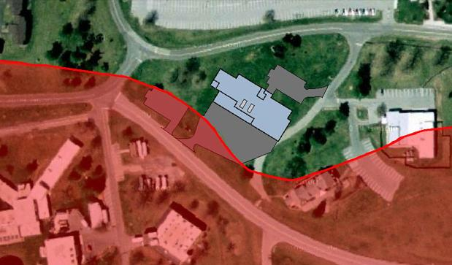
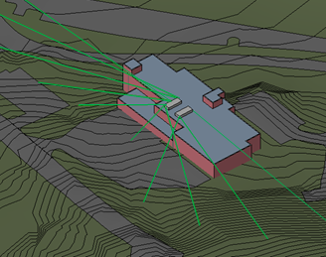
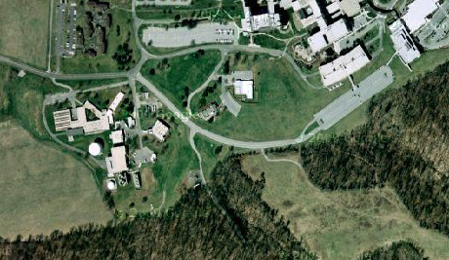
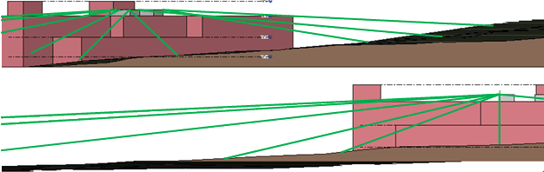
SUPPORT SERVICES BUILDING
PENN STATE MILTON S. HERSHEY MEDICAL CENTER
ANALYSIS II: ELIMINATION OF OFFSET ROOF
WILL LAZRATION
CONSTRUCTION MANAGEMENT
PRESENTATION OUTLINE:
PROJECT BACKGROUND
ANALYSIS #1: FOUNDATION RE-DESIGN
  Initial Conditions
  Re-Design
ANALYSIS #2: ROOFING
  Part I: Roofing Type Comparison
  Part II: Elimination of Offset Roof
ANALYSIS #3: RENEWABLE ENERGY
  Part I: Geothermal System
  Part II: Installation of PV Array
    Site Analysis
    System Design (E)
LESSONS LEARNED
ACKNOWLEDGEMENTS
LINE OF SIGHT STUDY
MATERIAL COST SAVINGS
  $41,030.00
SCHEDULE SAVINGS
  1 week
TOTAL COST SAVINGS
  $55,314.00

Slide 16
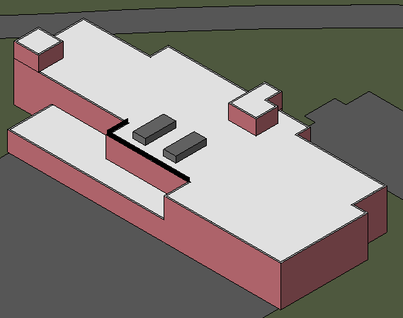
SUPPORT SERVICES BUILDING
PENN STATE MILTON S. HERSHEY MEDICAL CENTER
ANALYSIS II: ROOFING
WILL LAZRATION
CONSTRUCTION MANAGEMENT
PRESENTATION OUTLINE:
PROJECT BACKGROUND
ANALYSIS #1: FOUNDATION RE-DESIGN
  Initial Conditions
  Re-Design
ANALYSIS #2: ROOFING
  Part I: Roofing Type Comparison
  Part II: Elimination of Offset Roof
ANALYSIS #3: RENEWABLE ENERGY
  Part I: Geothermal System
  Part II: Installation of PV Array
    Site Analysis
    System Design (E)
LESSONS LEARNED
ACKNOWLEDGEMENTS
CONCLUSION
  There is no one single preferred roofing type for all projects
  Sustainable roofs are no longer limited to one or two types
RECOMMENDATIONS
  Architects/Engineers should consider buildings function & owner wants before selecting a roof
  Cold Applied BUR was proper choice for the SSB
SSB with Offset Roof Eliminated

Slide 17
SUPPORT SERVICES BUILDING
PENN STATE MILTON S. HERSHEY MEDICAL CENTER
ANALYSIS III: RENEWABLE RESOURCES
WILL LAZRATION
CONSTRUCTION MANAGEMENT
PRESENTATION OUTLINE:
PROJECT BACKGROUND
ANALYSIS #1: FOUNDATION RE-DESIGN
  Initial Conditions
  Re-Design
ANALYSIS #2: ROOFING
  Part I: Roofing Type Comparison
  Part II: Elimination of Offset Roof
ANALYSIS #3: RENEWABLE ENERGY
  Part I: Geothermal System
  Part II: Installation of PV Array
    Site Analysis
    System Design
LESSONS LEARNED
ACKNOWLEDGEMENTS
PROBLEM IDENTIFICATION
  SSB utilized very few sustainable techniques
  SSB generates no income to offset operating costs
  PSU has no buildings that incorporate onsite renewable energy
RESEARCH GOALS
  Design preliminary onsite renewable energy systems
  Make the SSB a research platform for PSU

Slide 18
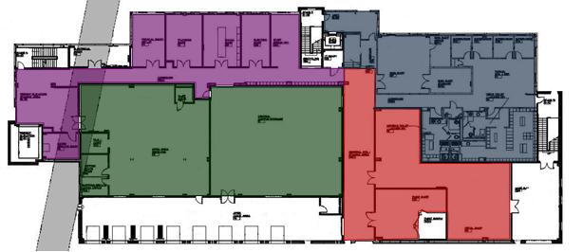
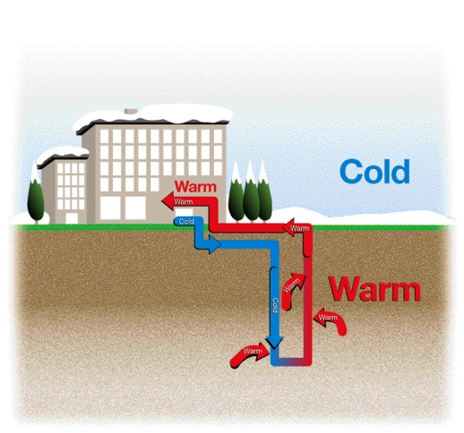
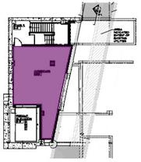
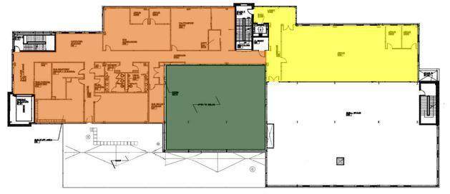
SUPPORT SERVICES BUILDING
PENN STATE MILTON S. HERSHEY MEDICAL CENTER
ANALYSIS III: GEOTHERMAL
WILL LAZRATION
CONSTRUCTION MANAGEMENT
PRESENTATION OUTLINE:
PROJECT BACKGROUND
ANALYSIS #1: FOUNDATION RE-DESIGN
  Initial Conditions
  Re-Design
ANALYSIS #2: ROOFING
  Part I: Roofing Type Comparison
  Part II: Elimination of Offset Roof
ANALYSIS #3: RENEWABLE ENERGY
  Part I: Geothermal System
  Part II: Installation of PV Array
    Site Analysis
    System Design (E)
LESSONS LEARNED
ACKNOWLEDGEMENTS
1st Floor
GEOTHERMAL SYSTEM
  Closed Loop Ground System
  40 Wells
  Building broke down into 6 zones
  Total additional cost added to project: $478,000.00
Lower Level
2nd Floor
Image Taken From www.mcquay.com

Slide 19
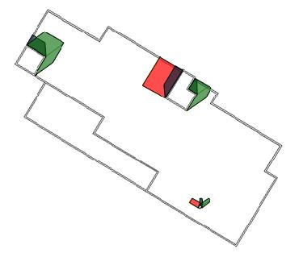
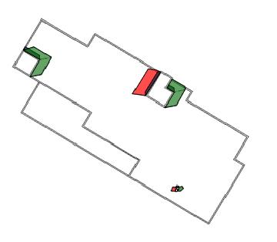
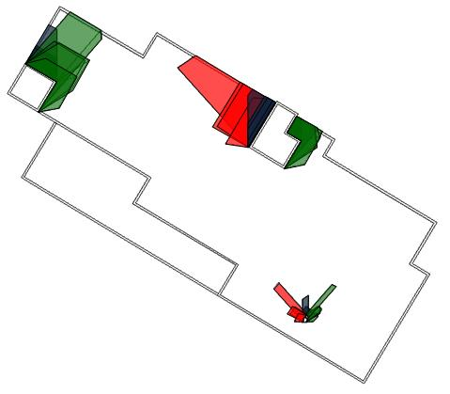

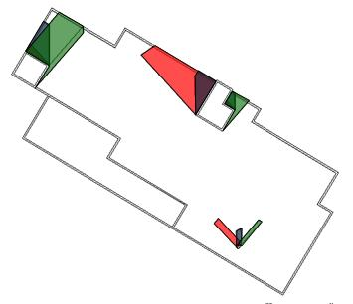
SUPPORT SERVICES BUILDING
PENN STATE MILTON S. HERSHEY MEDICAL CENTER
ANALYSIS III: PHOTOVOLTAIC ARRAY SYSTEM
WILL LAZRATION
CONSTRUCTION MANAGEMENT
PRESENTATION OUTLINE:
PROJECT BACKGROUND
ANALYSIS #1: FOUNDATION RE-DESIGN
  Initial Conditions
  Re-Design
ANALYSIS #2: ROOFING
  Part I: Roofing Type Comparison
  Part II: Elimination of Offset Roof
ANALYSIS #3: RENEWABLE ENERGY
  Part I: Geothermal System
  Part II: Installation of PV Array
    Site Analysis
    System Design (E)
LESSONS LEARNED
ACKNOWLEDGEMENTS
SITE & BUILDING SHADE ANALYSIS
  Sun Position in sky
  Optimum solar window: 9:00 AM – 3:00PM
  No shade on building
  Rooftop projection shadows
Spring Equinox
Summer Solstice
Day | Spring Equinox - March 20th/21st
Time | 9:00 A.M. | 12:00 P.M. | 3:00 P.M.
Altitude Angle (°) | 30.66 | 49.98 | 35.14
Azimuth Angle (South = 0°) | -60.43 | -5.33 | 54.25
Day | Summer Solstice - June 21st/22nd
Time | 9:00 A.M. | 12:00 P.M. | 3:00 P.M.
Altitude Angle (°) | 47.2 | 73.07 | 50.34
Azimuth Angle (South = 0°) | -81.5 | -6.6 | 78.15
Day | Fall Equinox - September 22nd/23rd
Time | 9:00 A.M. | 12:00 P.M. | 3:00 P.M.
Altitude Angle (°) | 32.93 | 49.89 | 32.61
Azimuth Angle (South = 0°) | -57.11 | 0.30 | 57.39
Day | Winter Solstice - December 21st/22nd
Time | 9:00 A.M. | 12:00 P.M. | 3:00 P.M.
Altitude Angle (°) | 13.1 | 26.27 | 14.42
Azimuth Angle (South = 0°) | -42.91 | -1.33 | 40.87
Overlay of all 4 days
Fall Equinox
Winter Solstice

Slide 20
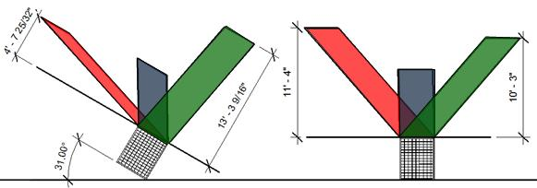
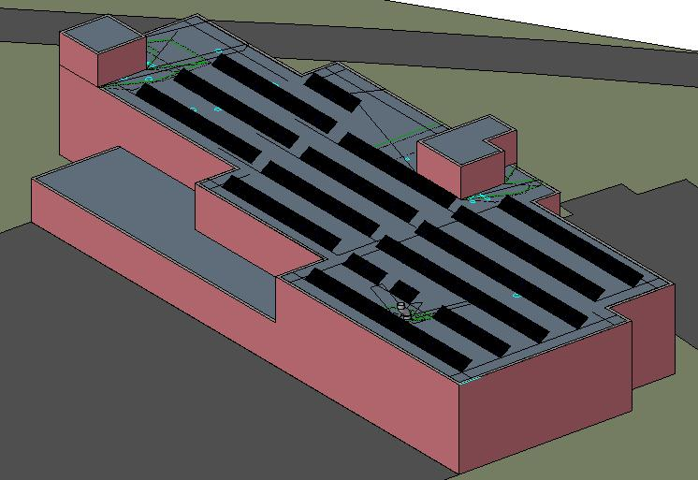
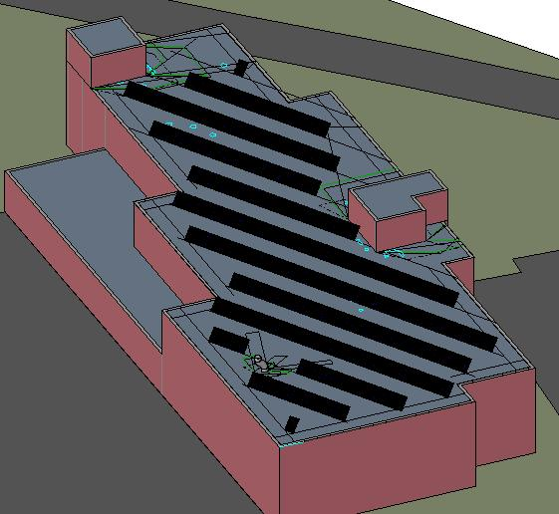
SUPPORT SERVICES BUILDING
PENN STATE MILTON S. HERSHEY MEDICAL CENTER
ANALYSIS III: PHOTOVOLTAIC ARRAY SYSTEM
WILL LAZRATION
CONSTRUCTION MANAGEMENT
PRESENTATION OUTLINE:
PROJECT BACKGROUND
ANALYSIS #1: FOUNDATION RE-DESIGN
  Initial Conditions
  Re-Design
ANALYSIS #2: ROOFING
  Part I: Roofing Type Comparison
  Part II: Elimination of Offset Roof
ANALYSIS #3: RENEWABLE ENERGY
  Part I: Geothermal System
  Part II: Installation of PV Array
    Site Analysis
    System Design
LESSONS LEARNED
ACKNOWLEDGEMENTS
9:00 AM 12:00 PM 3:00 PM
ARRAY ORIENTATION & TILT COMPARISON
Angle | Array Orientation | Min. Row Spacing to Avoid Shading | Max # of Panels | kWh/ Panel/ Year
35° | Rotated 31° | 11'-10" | 252 | 385.39
 | Due South | 9'-9" | 253 | 399.34
30° | Rotated 31° | 10'-5" | 248 | 386.42
 | Due South | 8'-8" | 269 | 398.81
Minimum Row Spacing Determined by Shadow Lengths
FINAL SYSTEM DESIGN
  Due south orientation
  1-axis tracking (adjustable tilt)
  Row spacing = minimum per 35°
Rotated 31° Orientation with 35° Tilt
Due South Orientation with 35° Tilt

Slide 21
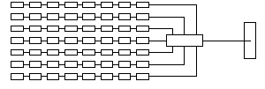
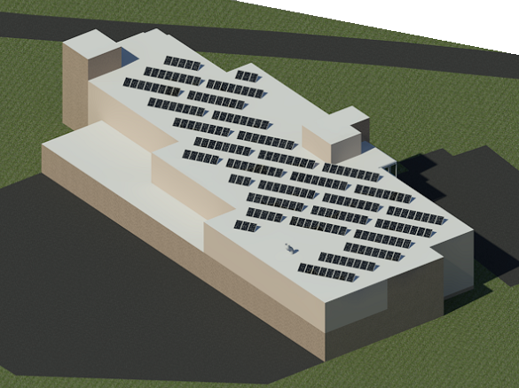
SUPPORT SERVICES BUILDING
PENN STATE MILTON S. HERSHEY MEDICAL CENTER
ANALYSIS III: PHOTOVOLTAIC ARRAY SYSTEM
WILL LAZRATION
CONSTRUCTION MANAGEMENT
PRESENTATION OUTLINE:
PROJECT BACKGROUND
ANALYSIS #1: FOUNDATION RE-DESIGN
  Initial Conditions
  Re-Design
ANALYSIS #2: ROOFING
  Part I: Roofing Type Comparison
  Part II: Elimination of Offset Roof
ANALYSIS #3: RENEWABLE ENERGY
  Part I: Geothermal System
  Part II: Installation of PV Array
    Site Analysis
    System Design (E)
LESSONS LEARNED
ACKNOWLEDGEMENTS
SATCON POWERGATE PLUS 75kW INVERTER
  6 combiner inputs rated at 80A
  7 string per inverter input
SUNPOWER E19-320 MODULES
  Per NEC max PV array voltage = 600V
  Max voltage calculated at lowest ambient temperature:
  Maximum Module Voltage = 72.22V
  600V/72.22V = 8.3 => 8 Modules in series max
Combiner Input in Inverter
DC Combiner
8 Module Sting, Isc = 6.24A
FINAL LAYOUT & SYSTEM SIZE
28 Strings * 8 modules/string * 320W = 71.68kW
6.24 A/string * 7 strings * 1.56 = 68.14A
68.14A < 80A => OK

Slide 22
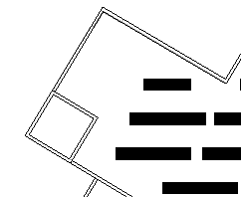
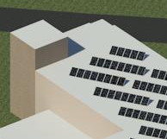

SUPPORT SERVICES BUILDING
PENN STATE MILTON S. HERSHEY MEDICAL CENTER
ANALYSIS III: PHOTOVOLTAIC ARRAY SYSTEM
WILL LAZRATION
CONSTRUCTION MANAGEMENT
PRESENTATION OUTLINE:
PROJECT BACKGROUND
ANALYSIS #1: FOUNDATION RE-DESIGN
  Initial Conditions
  Re-Design
ANALYSIS #2: ROOFING
  Part I: Roofing Type Comparison
  Part II: Elimination of Offset Roof
ANALYSIS #3: RENEWABLE ENERGY
  Part I: Geothermal System
  Part II: Installation of PV Array
    Site Analysis
    System Design
LESSONS LEARNED
ACKNOWLEDGEMENTS
Feed From Inverter to Combiner Panel/Box Sizing
Max current from inverter data sheet: 91A/phase
91A x 1.56 (NEC Multiplier) = 142A
NEC Table 310.15(B)(2)(a): Multiplier for 4-6 current carrying conductors in a raceway = 0.8
NEC Table 310.16 (90°C Wire): 2/0 AWG = 195A
195A x 0.8 = 156A > 142A => OK
LOAD SIDE CONNECTION
Inverter Location
15kV Utility In
DC Power From Array
500 kVA Transformer
Satcon 75kW Inverter
1 set of (4) 2/0 AWG
Net Meter
Production Meter
AC FUSED DISCONNECT SWITCH SIZING
Max current from inverter data sheet: 91A/phase
91A x 3 phases 1.25 (NEC Multiplier) = 342A
Ideal fused disconnect switch size: 350A => not available => 400A
Interrupt Rating must be greater than; 500kVA / (.480kV * 3^^{(1/2)} = 600A
Combiner Panel/Box
Load Meter
400A AC Fused Disconnect Switch
Main Distribution Panel

Slide 23


SUPPORT SERVICES BUILDING
PENN STATE MILTON S. HERSHEY MEDICAL CENTER
ANALYSIS III: PHOTOVOLTAIC ARRAY SYSTEM
WILL LAZRATION
CONSTRUCTION MANAGEMENT
PRESENTATION OUTLINE:
PROJECT BACKGROUND
ANALYSIS #1: FOUNDATION RE-DESIGN
  Initial Conditions
  Re-Design
ANALYSIS #2: ROOFING
  Part I: Roofing Type Comparison
  Part II: Elimination of Offset Roof
ANALYSIS #3: RENEWABLE ENERGY
  Part I: Geothermal System
  Part II: Installation of PV Array
    Site Analysis
    System Design (E)
LESSONS LEARNED
ACKNOWLEDGEMENTS
STRING TO DC COMBINER BOX WIRE SIZING
Isc: 6.24A
Maximum String Current = 6.24A * 1.56 (NEC multiplier for wire sizing) = 9.73A
From NEC Table 310.15(B)(2)(c): 22°C
Adjusted Temperature = (36°C + 22°C) = 58°C
From NEC Table 310.16: 0.71 for 90°C wire
From NEC Table 310.16, #12 AWG 90°C Wire =
25A * .71 = 17.75A> 9.73 => Ok.
Common practice is to us a minimum of #10AWG for PV Systems
String to DC Combiner box Wire Size:
#8 AWG
STRING TO DC COMBINER BOX POWER LOSS CHECK
Power Loss Equation =
From NEC table 8: Wire factor for #10AWG = 1.26Ω/kFT
Average Wire Length: 50ft
Imp= 5.86A
Power Loss =
=> Increase wire size to # 8 to limit power loss
Module to Module Wire Size: #10 AWG
DC Combiner box to Inverter Wire Size: #2 AWG
System Design: 4 Identical groups as shown above

Slide 24
SUPPORT SERVICES BUILDING
PENN STATE MILTON S. HERSHEY MEDICAL CENTER
ANALYSIS III: PHOTOVOLTAIC ARRAY SYSTEM
WILL LAZRATION
CONSTRUCTION MANAGEMENT
PRESENTATION OUTLINE:
PROJECT BACKGROUND
ANALYSIS #1: FOUNDATION RE-DESIGN
  Initial Conditions
  Re-Design
ANALYSIS #2: ROOFING
  Part I: Roofing Type Comparison
  Part II: Elimination of Offset Roof
ANALYSIS #3: RENEWABLE ENERGY
  Part I: Geothermal System
  Part II: Installation of PV Array
    Site Analysis
    System Design (E)
LESSONS LEARNED
ACKNOWLEDGEMENTS
PV SYSTEM ESTIMATE
Item | Description | Cost
Resized Steel Joists |  | $1,106.20
Sunpower E19-320 Solar Modules |  | $476,400.00
Sacton Powergate Plus 75kW Inverter |  | $36,000.00
Wire |  | $5,538.00
Misc. |  | $26,740.00
Total Cost: |  | $545,784.20
ESTIMATED COST OF SYSTEM
Cost of PV System Alone: $545,784.00
  OPTION 1: Relocated RTU’s to lower roof
    Total Cost: $495,004.00
  OPTION 2: Installation with Geothermal System
    Total Cost: $967,702.00
ESTIMATED YEARLY OUTPUT OF SYSTEM
From PVWatts: 102,240 kWh
Total Value of Electricity Produced ≈ $10,000.00
Estimated yearly building electric usage: 547,500 kWh
Percent PV system will offset building usage: 19%

Slide 25
SUPPORT SERVICES BUILDING
PENN STATE MILTON S. HERSHEY MEDICAL CENTER
ANALYSIS III: PHOTOVOLTAIC ARRAY SYSTEM
WILL LAZRATION
CONSTRUCTION MANAGEMENT
PRESENTATION OUTLINE:
PROJECT BACKGROUND
ANALYSIS #1: FOUNDATION RE-DESIGN
  Initial Conditions
  Re-Design
ANALYSIS #2: ROOFING
  Part I: Roofing Type Comparison
  Part II: Elimination of Offset Roof
ANALYSIS #3: RENEWABLE ENERGY
  Part I: Geothermal System
  Part II: Installation of PV Array
    Site Analysis
    System Design (E)
LESSONS LEARNED
ACKNOWLEDGEMENTS
CONCLUSION
  SSB roof idea for photovoltaic array
  98% of additional cost to add a Geothermal system is the installation of the wells & horizontal piping
RECOMMENDATIONS
  Install both Geothermal & PV array on SSB
  PSU can use SSB to research operating techniques of buildings with these systems to figure out best way to incorporate them into their building projects of the future

Slide 26
SUPPORT SERVICES BUILDING
PENN STATE MILTON S. HERSHEY MEDICAL CENTER
LESSONS LEARNED
WILL LAZRATION
CONSTRUCTION MANAGEMENT
PRESENTATION OUTLINE:
PROJECT BACKGROUND
ANALYSIS #1: FOUNDATION RE-DESIGN
  Initial Conditions
  Re-Design
ANALYSIS #2: ROOFING
  Part I: Roofing Type Comparison
  Part II: Elimination of Offset Roof
ANALYSIS #3: RENEWABLE ENERGY
  Part I: Geothermal System
  Part II: Installation of PV Array
    Site Analysis
    System Design (E)
LESSONS LEARNED
ACKNOWLEDGEMENTS
ANALYSIS I:
Minimum Geopier element spacing often governs design
Cost to increase concrete foundation element sizes is minimal compared to total cost of project
ANALYSIS II:
Sustainable roofing goes beyond LEED
A cheaper roof is not always the best choice for every project
ANALYSIS III:
Wire size is often governed by power loss, not NEC minimum requirements
PV array layout on rotated buildings needs to be analyzed closely

Slide 27
SUPPORT SERVICES BUILDING
PENN STATE MILTON S. HERSHEY MEDICAL CENTER
ACKNOWLEDGEMENTS
WILL LAZRATION
CONSTRUCTION MANAGEMENT
PRESENTATION OUTLINE:
PROJECT BACKGROUND
ANALYSIS #1: FOUNDATION RE-DESIGN
  Initial Conditions
  Re-Design
ANALYSIS #2: ROOFING
  Part I: Roofing Type Comparison
  Part II: Elimination of Offset Roof
ANALYSIS #3: RENEWABLE ENERGY
  Part I: Geothermal System
  Part II: Installation of PV Array
    Site Analysis
    System Design (E)
LESSONS LEARNED
ACKNOWLEDGEMENTS
ALEXANDER BUILDING CONSTRUCTION Co.
Mr. Mike Stambaugh
Mr. Dan Flickinger
Mr. Bradley Spade
Mr. Steven Wilt
Mr. Jeffrey Smith
Mr. Dave Carll
Mr. Nick Miller
SPECIAL THANKS TO:
The Pennsylvania State University
Penn State Milton S. Hershey Medical Center
PENN STATE UNIVERSITY
Dr. David Riley
Mr. Clive Dorrell
Prof. Robert Holland
Dr. M. Kevin Parfait
Dr. Finley Shaprio
CMT LABORATORIES Inc.
Mr. J.P. Thornton
TREMCO ROOFING
Mr. Randy Kline

Slide 28
SUPPORT SERVICES BUILDING
PENN STATE MILTON S. HERSHEY MEDICAL CENTER
WILL LAZRATION
CONSTRUCTION MANAGEMENT
QUESTIONS
?

